Slide 1

MACHINE LEARNING CAPSTONE PROJECT
LAPTOP PRICE PREDICTOR
Submitted by :-
Shalu Chauhan
Batch – DS41B
SID- S8252

Slide 2
CONTENTS-
1.
Data preprocessing- dropping irrelevant columns / null missing values handling
Categorising into data type
5.
Creating Colum transformers /Pipeline
6.
Testing algorithms -
7.
Launching via gradio application
Logarithmic conversion
Hyperparameter tuning
3.
Feature Transformation – BINNING in nominal columns
Feature selection – hypothesis test/ EDA
4.
Feature engineering / Feature creation– memory, CPU, GPU, screen resolution
Feature selection EDA

Slide 3
UNDERSTANDING THE DATA
CATEGORICAL DATA
Company,
NUMERICAL DATA
Continuous -
MIXED DATA
CPU
Type-name,
Ops
Weight
Prices
RAM
Memory
GPU
Screen resolution
Inches
Discrete-

Slide 4
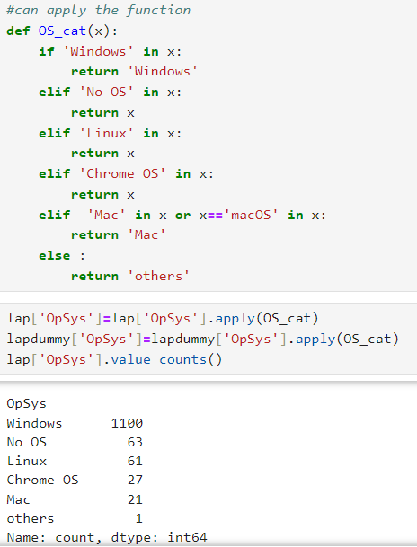
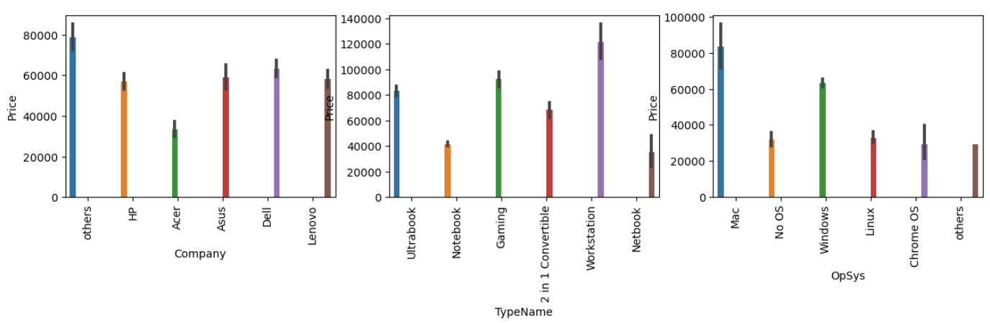
FEATURE TRANSFORMATION- USING CATEGORISATION STRATEGY – COMPANY, TYPENAME, OPSYS COLUM
Observation – most values are centred in a few categories, thus leaving few major categories others can be clubbed
FEATURE TRANSFORMATION- using functions and conditionals
FEATURE SELECTION-
GRAPHICALLY- we can observe that

Slide 5
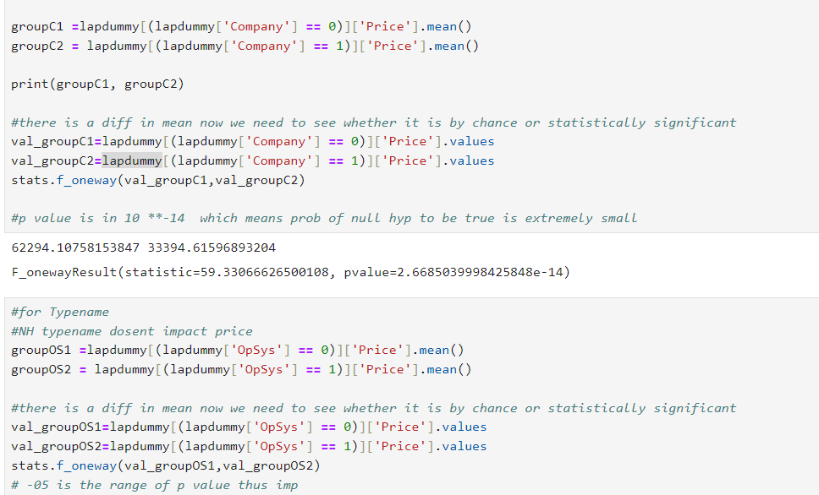
PERFORMING ANOVA FOR NOMINAL COLUMS
Why ANOVA –
Categorical with multiple groups vs numerical Price
Used a dummy data set as the primary purpose was to justify the visual representation and select feature
Final will be performed by transformers in the pipeline
Observation –
Sine null hypothesis is that there is no impact of these variables on prices
p-value is in negative powers thus < 0.5
implies that the possibility of happening of the null hypothesis is scarce thus reject it.

Slide 6
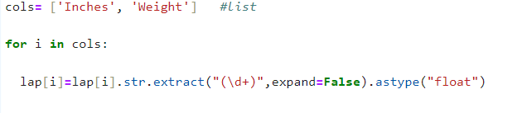
DEALING WITH COLUMNS HAVING CONTINUOUS VARIABLES - PRICE, SIZE, WEIGHT
FORMATTING DATATYPE TO INTEGER /FLOAT
Extracting the numerical part and avoiding the units which are string in weight and ram column
Checking the outliers and the distributions of all the columns
CLIPPING STRATEGY to remove outliers for all three columns as a ram doesn’t have outliers
EDA- scatter plot
f
Feature selection based on correlation coefficient
DATA PREPROCESSING – OUTLER REMOVAL

Slide 7
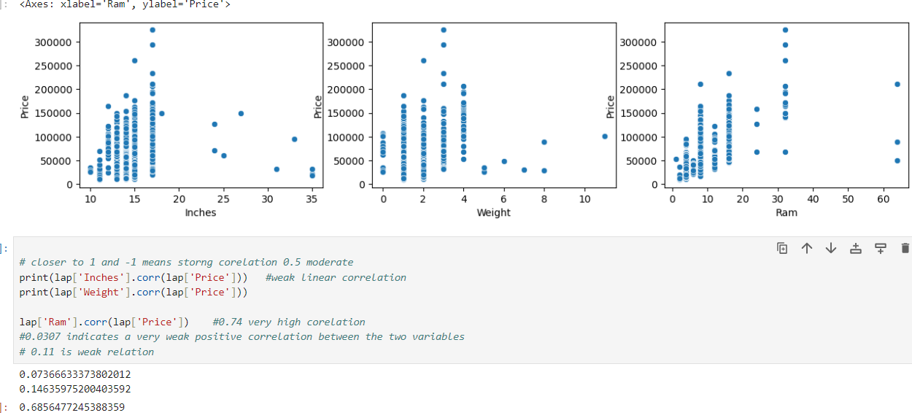
FEATURE SELECTION
1. The scatter plot already shows no linear link between the variables more like clusters
2. The same thing was proved by the correlation test
3. Further these will be scaled using standard scaler in the column transformers

Slide 8
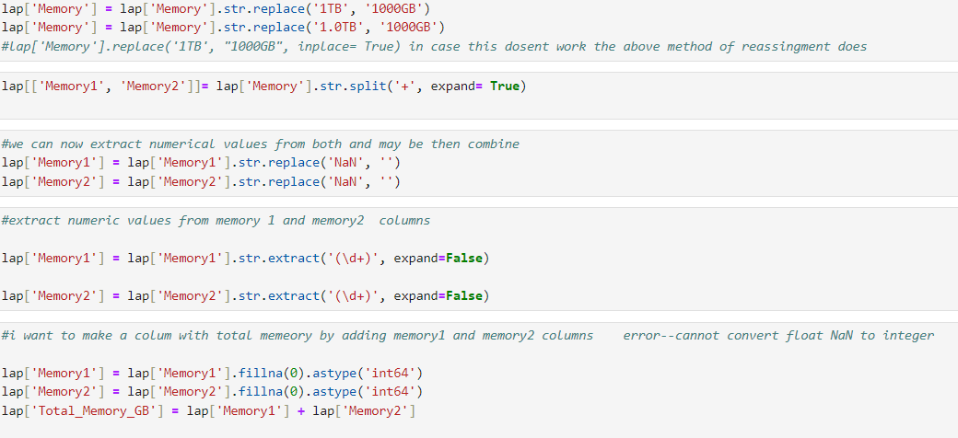
DEALING WITH MIXED COLUMNS THE MEMORY COLUMN/
OBSERVATION – via value counts –
Most common are SSD, HDD, Hybrid of both, flash storage
Also, converting 1 TB into GB for unit standardisation
Treating the Hybrid column – using split expand and replace
Putting them as 2 separate memories
Then combine these two as one by concatenating
This gave me a standardised numerical part from mixed comul
Overall extracting the numerical part and

Slide 9
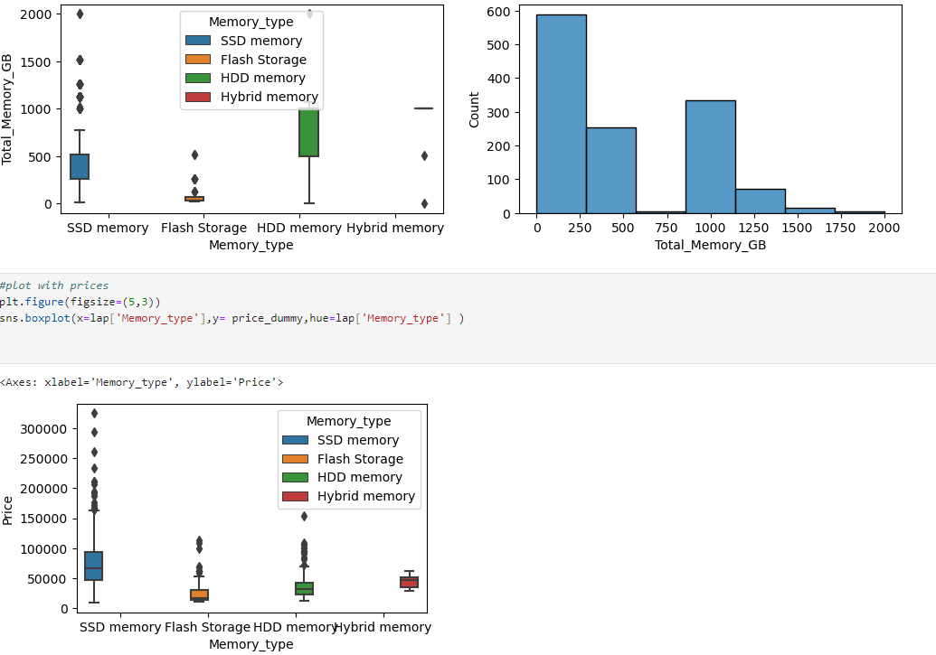
Extracting the categorical part
Further using the categorising strategy to summarise the vast number of categories into major ones
def memory_type(x):
if 'SSD' in x: return 'SSD memory’
elif 'HDD' in x: return 'HDD memory’
elif 'Flash Storage' in x: return 'Flash Storage’
else: return 'Hybrid
memory'lap['Memory_type’]=
lap['Memory'].apply(memory_type)
TESTING CORRELATION –
lap['Total_Memory_GB'].corr(lap['Price’])
P value is around 0.2
Thus slight correlation
But since our domain knowledge says that it does impact hence we cant ignore it

Slide 10
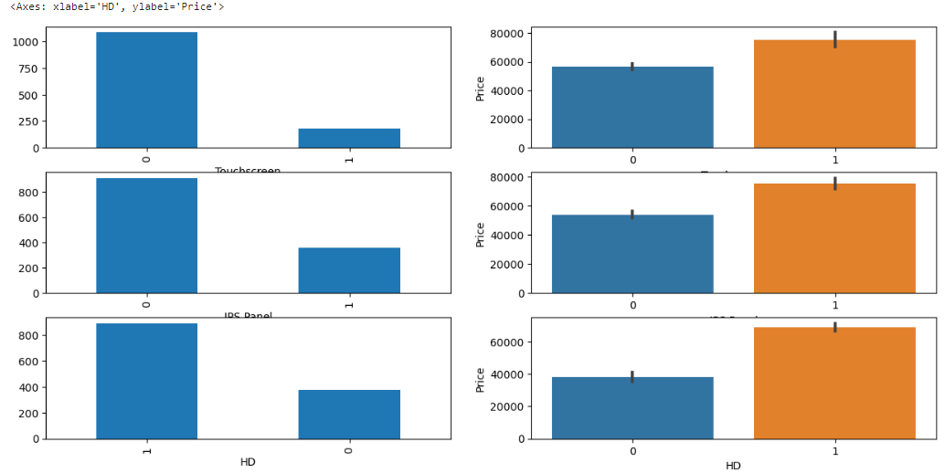
LAPTOP RESOLUTION COLUM
OBSERVATION – numerical and categorical part both there
Used slicing to extract the numerical part
lap['Pickles']=lap['ScreenResolution'].apply(lambda x: x.split()[-1])
#they are at -1indexlap['Pickles'] #discrete so we just need to normalise it
Feature creation – new column called pickles
Further dividing it into X and Y resolution to standardise further
pic=lap['Pickles'].str.split('x', n=1,expand=True)
lap['x_res']=pic[0] , lap['y_res']=pic[1]
DEALING WITH CATEGORICAL PART- FEATURE ENGINEERING
Most frequent categories – IPS , HD, Touchscreen
Thus used lambda to form these categories and

Slide 11
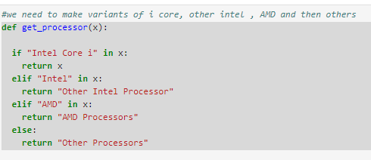
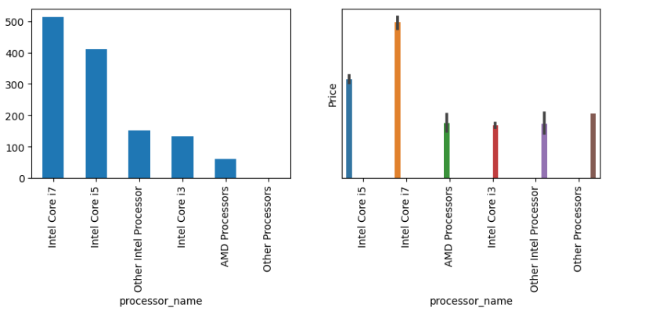
TRANSFORMING THE CPU COLUMN
OBSERVATION – Numerical – CPU frequency
Categorical- CPU or processor name
CATEGORICAL- most common intel I core then AMD
Applied function to categorise them
lap['processor_name']=lap['processor_name'].apply(lambda x: " ".join(x.split()[0:3])) #as it is seen that till 2nd index we have name so we slice AND join these
NUMERICAL – extract using slicing -1 index

Slide 12
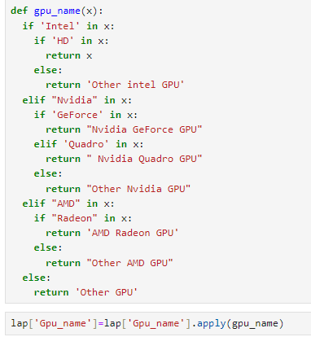
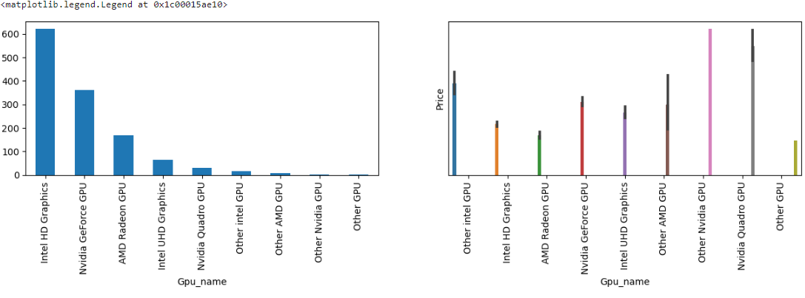
TRANSFORMING THE GPU COLUMN
OBSERVATION –
In the categorical part intel iris, HD, UHD, Nvidia GeForce or Nvidia other, AMD Radeon or other AMD are different types.
Extracting Categorical via indexing –
lap['Gpu_name']= lap['Gpu'].apply(lambda x: " ".join(x.split()[0:3]))lap['Gpu_name’]
Applying function to categorise –
DEALING WITH NUMERICAL PART-
lap['GPU_version']= lap['Gpu'].apply(lambda x:x.split()[-1])lap['GPU_version']=lap['GPU_version'].str.extract('(\d+)',expand=False)lap['GPU_version'].fillna(0, inplace=True)lap['GPU_version'] = pd.to_numeric(lap['GPU_version'], errors='coerce')

Slide 13
SELECTING TRANSFORMATION STRATEGY
1.
Nominal columns now are – company, type name, Opsys,
2.
NUMERICAL COLUMNS - 'Total_Memory_GB', 'Weight’, and 'Inches’
3.
In numerical columns -'x_res', 'y_res','Ram'
We use MinMaxScaler()
'Memory_type','processor_name','Gpu_name'
Thus strategy – ONE HOT ENCODING
more difference in ranges and even the units are different we use StandardScaler()

Slide 14
ML Modelling and Gradio application
TESTING THE RIGHT ALGORITHM
Additionally observations –
Removing the columns like inches and weight had a negative impact on scores despite their weak correlation with price
Probably data not sufficient enough
By removing sparse= False and drop first the r2 inc by 1 unit again
Metrics –
r2_score,mean_squared_error, mean_absolute_error
Tree based algorithms performed better –random forest regressor
Important steps –
Converting the Price using logarithmic function – help normalise the distribution
Increased r value to 85
Adding hyperparameter-
max_features= 0.90, max_samples= 0.80, n_estimators= 300, min_samples_split= 10
Major change brought by changing random sampling to 1 from 42
R2 score inc from .85 to .88

Slide 15
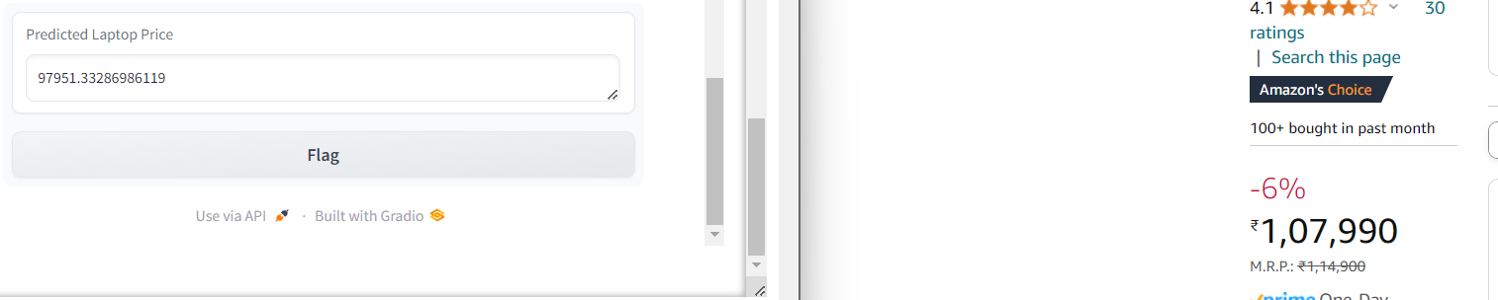
SOME REAL-TIME PREDICTIONS
MORE EXPENSIVE BRANDS LIKE APPLE – 3k- but probably due to lack of processor and GPU specification very high range not predicted good . Also, the data for mac was less than 100 laptops
PREDICTION FOR MEDIUM RANGE known brands – pretty good as the specifications and data was a lot
PREDICTION FOR GAMING- pretty accurate
PREDICTION FOR convertible/ips/touchscreen LAPTOPS- 6k
PREDICTION FOR convertible/ips/touchscreen AMD LAPTOPS –
There is a 10k diff

Slide 16
For popular brand but touchscreen the prediction suffered. Data less
VERY HIGH end gaming laptop also not able to predict eg HP gaming. Probably due to more specifications in real world and less Data

Slide 17
Thank You !

